Slide 1
NITHIN N S
214421@ust-global.com

Slide 2
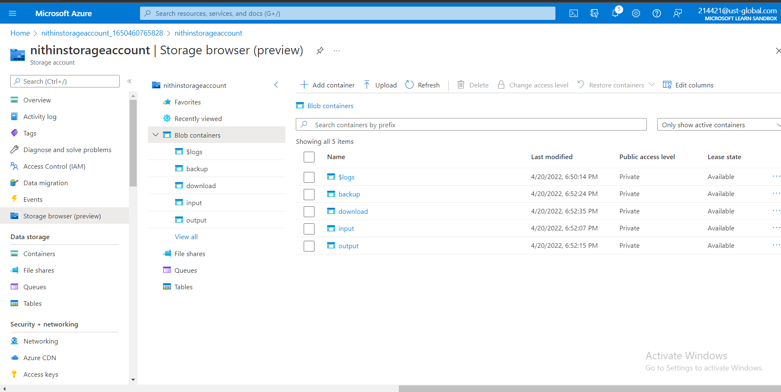
Storage account in Azure with 4 containers

Slide 3
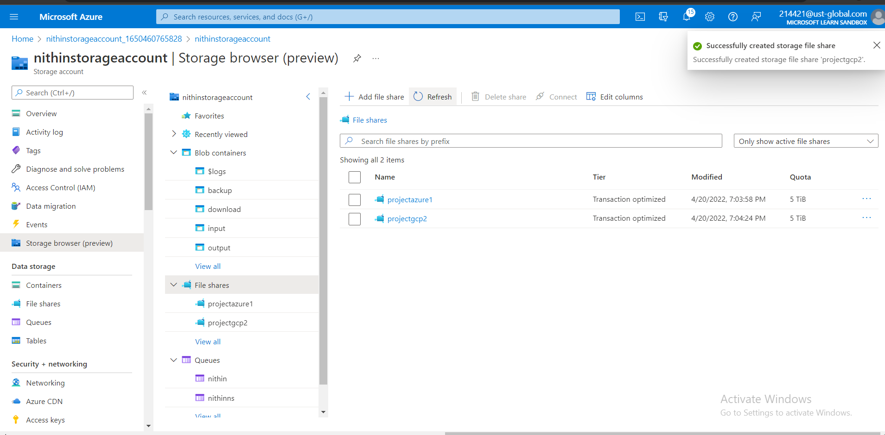
File share with two directories

Slide 4
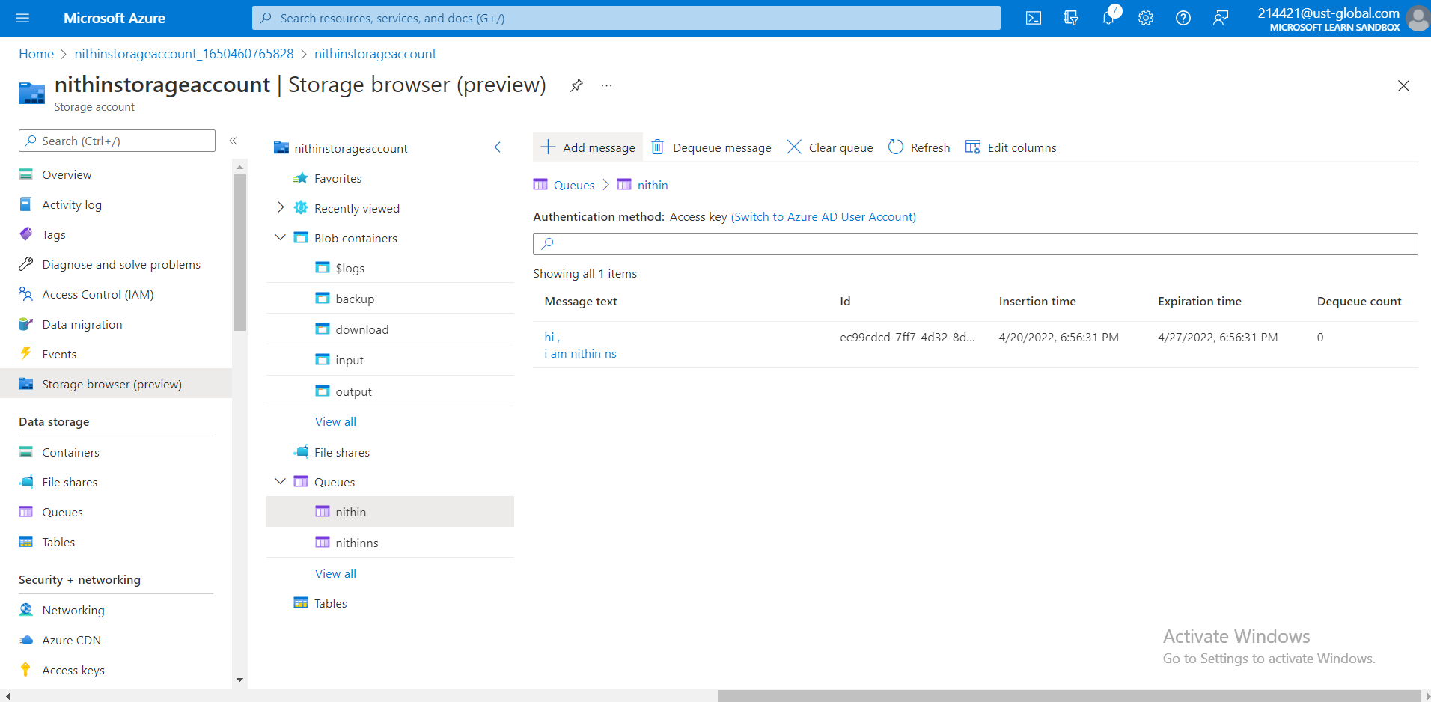
Message Queue with a message

Slide 5
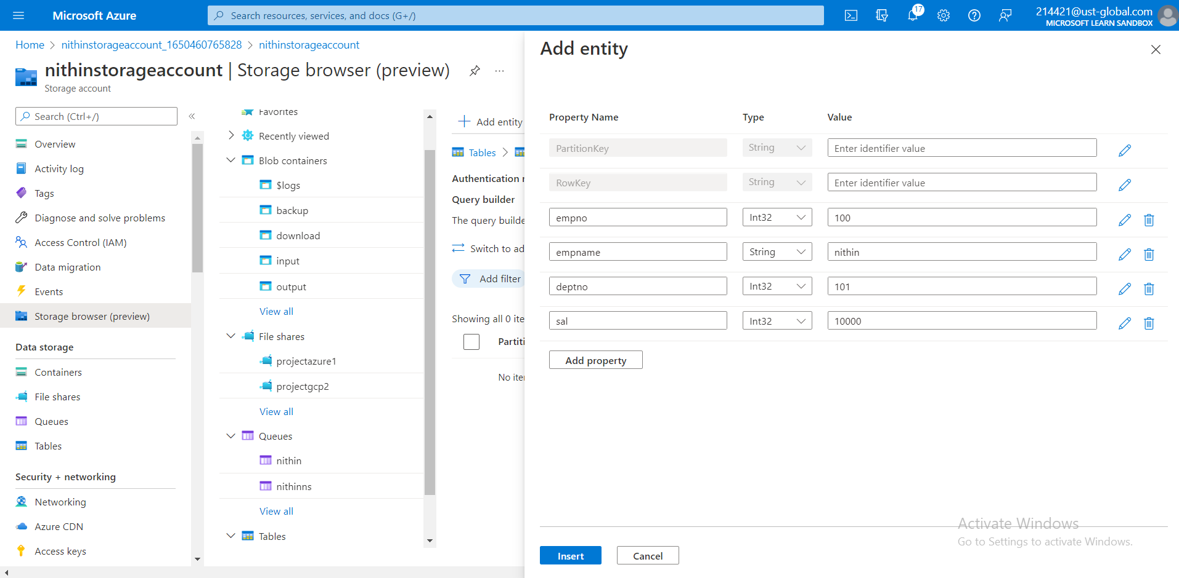
Table

Slide 6
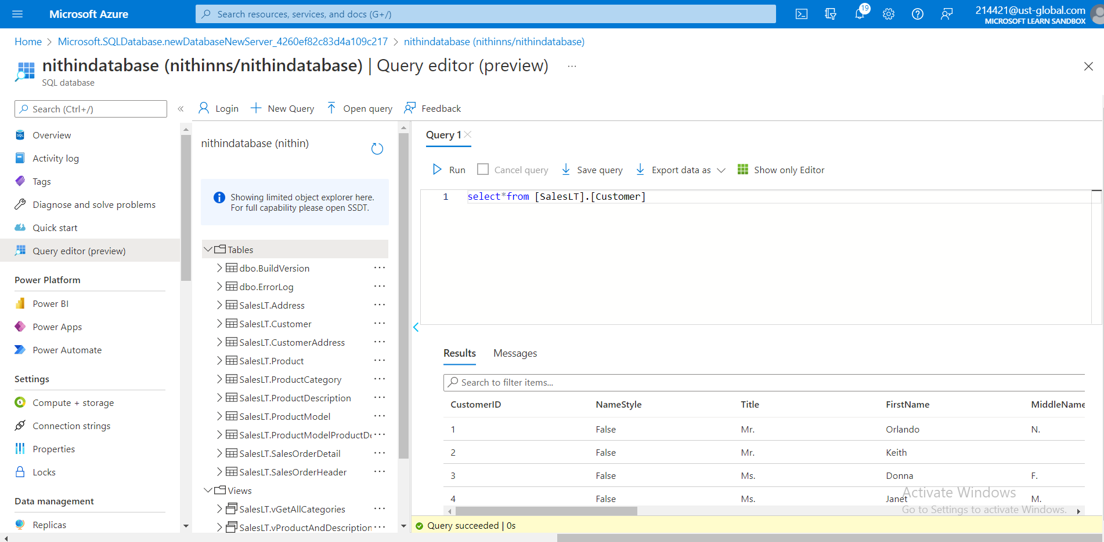
Sample Database with query

Slide 7
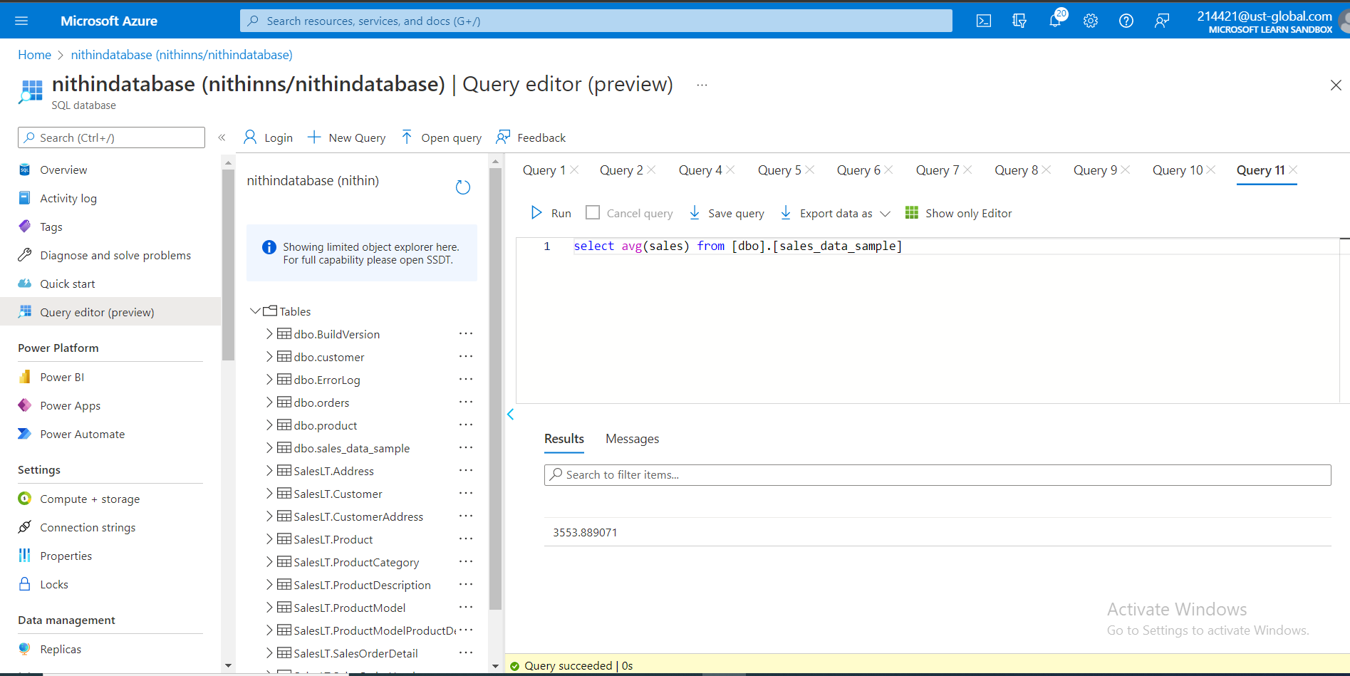
Sample Database with Dimensions & Fact Tables-To estimate the unit sales of retail goods

Slide 8
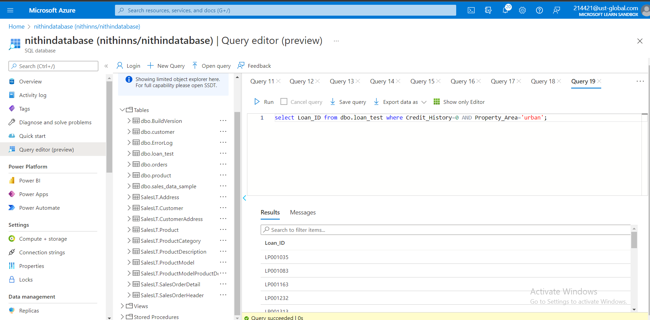
Sample Database with Dimensions & Fact Tables-Financial need programs for consumer loan products

Slide 9
THANK YOU

